Slide 2
Topics
Introduction to Repetition Structures
The while Loop: a Condition-Controlled Loop
The for Loop: a Count-Controlled Loop
Calculating a Running Total
Sentinels
Input Validation Loops
Nested Loops
Turtle Graphics: Using Loops to Draw Designs

Slide 3
Introduction to Repetition Structures
Often have to write code that performs the same task multiple times
  Disadvantages to duplicating code
    Makes program large
    Time consuming
    May need to be corrected in many places
Repetition structure: makes computer repeat included code as necessary
  Includes condition-controlled loops and count-controlled loops

Slide 4
The while Loop: a Condition-Controlled Loop
while loop: while condition is true, do something
  Two parts:
    Condition tested for true or false value
    Statements repeated as long as condition is true
  In flow chart, line goes back to previous part
  General format:
    while condition:
    statements

Slide 5
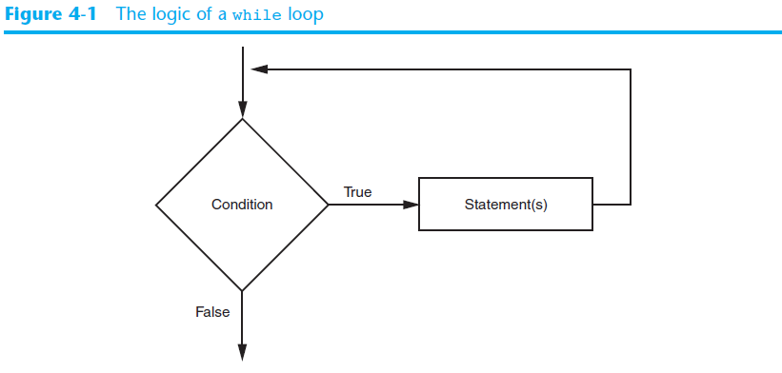
The while Loop: a Condition-Controlled Loop (cont’d.)

Slide 6
The while Loop: a Condition-Controlled Loop (cont’d.)
In order for a loop to stop executing, something has to happen inside the loop to make the condition false
Iteration: one execution of the body of a loop
while loop is known as a pretest loop
  Tests condition before performing an iteration
    Will never execute if condition is false to start with
    Requires performing some steps prior to the loop

Slide 7
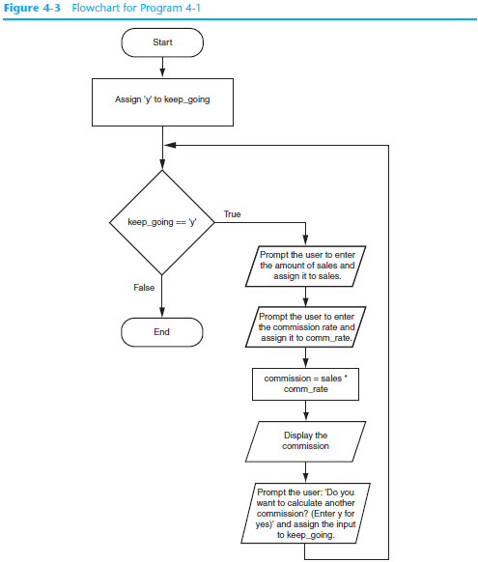

Slide 8
The while Loop: a Condition-Controlled Loop (cont’d.)
# Create a variable to control the loop.
keep_going = 'y'
# Calculate a series of commissions.
while keep_going == 'y':
# Get a salesperson's sales and commission rate.
sales = float(input('Enter the amount of sales: '))
comm_rate = float(input('Enter the commission rate: '))
# Calculate the commission.
commission = sales * comm_rate

Slide 9
The while Loop: a Condition-Controlled Loop (cont’d.)
# Display the commission.
print('The commission is $', \
format(commission, ',.2f'), sep='')
# See if the user wants to do another one.
keep_going = input('Do you want to calculate another ' + \
'commission (Enter y for yes): ')

Slide 10
The while Loop: a Condition-Controlled Loop (cont’d.)
Output:
Enter the amount of sales: 34
Enter the commission rate: 0.4
The commission is $13.60
Do you want to calculate another commission (Enter y for yes): y
Enter the amount of sales: 12
Enter the commission rate: 0.1
The commission is $1.20
Do you want to calculate another commission (Enter y for yes):

Slide 11
The while Loop
# This program assists a technician in the process
# of checking a substance's temperature.
max_temp = 102.5
temperature = float(input("Enter the substance's Celsius temperature: "))
while temperature > max_temp:
print('The temperature is too high.')
print('Turn the thermostat down and wait')
print('5 minutes. Then take the temperature')
print('again and enter it.')
temperature = float(input('Enter the new Celsius temperature: '))
print('The temperature is acceptable.')
print('Check it again in 15 minutes.')

Slide 12
The while Loop
Output:
Enter the substance's Celsius temperature: 125
The temperature is too high.
Turn the thermostat down and wait
5 minutes. Then take the temperature
again and enter it.
Enter the new Celsius temperature: 85
The temperature is acceptable.
Check it again in 15 minutes.
>>>

Slide 13
Infinite Loops
Loops must contain within themselves a way to terminate
  Something inside a while loop must eventually make the condition false
Infinite loop: loop that does not have a way of stopping
  Repeats until program is interrupted
  Occurs when programmer forgets to include stopping code in the loop

Slide 14
Infinite Loops
# This program demonstrates an infinite loop.
# Create a variable to control the loop.
keep_going = 'y'
while keep_going == 'y':
# Get a salesperson's sales and commission rate.
sales = float(input('Enter the amount of sales: '))
comm_rate = float(input('Enter the commission rate: '))
commission = sales * comm_rate
print('The commission is $', \
format(commission, ',.2f'), sep='')

Slide 15
Repeated Steps
Output:
5
4
3
2
1
Blastoff!
0
n = 5
Program:
n = 5
while n > 0 :
print(n)
n = n – 1
print('Blastoff!')
print(n)
No
n > 0 ?
Yes
print(n)
n = n -1
print('Blastoff')
Loops (repeated steps) have iteration variables that change each time through a loop. Often these iteration variables go through a sequence of numbers.

Slide 16
An Infinite Loop
n = 5
n = 5
while n > 0 :
print('Python')
print('Fighters')
print('Rock this!’)
No
n > 0 ?
Yes
print('Python')
print('Fighters')
print('Rock this!')
What is wrong with this loop?

Slide 17
Another Loop
n = 5
n = 0
while n > 0 :
print('Python')
print('Fighters')
print('Rock this!’)
No
n > 0 ?
Yes
print('Python')
print('Fighters')
print('Rock this!')
What is this loop doing?

Slide 18
Breaking Out of a Loop
The break statement ends the current loop and jumps to the statement immediately following the loop
It is like a loop test that can happen anywhere in the body of the loop
while True:
line = input('> ')
if line == 'done' :
break
print(line)
print('Done!')
> hello there
hello there
> finished
finished
> done
Done!

Slide 19
Breaking Out of a Loop
The break statement ends the current loop and jumps to the statement immediately following the loop
It is like a loop test that can happen anywhere in the body of the loop
while True:
line = input('> ')
if line == 'done' :
break
print(line)
print('Done!')
> hello there
hello there
> finished
finished
> done
Done!

Slide 20
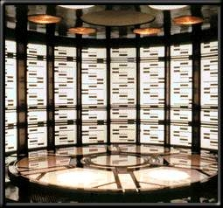
while True:
line = input('> ')
if line == 'done' :
break
print(line)
print('Done!')
No
True ?
Yes
....
break
...
http://en.wikipedia.org/wiki/Transporter_(Star_Trek)
print('Done')

Slide 21
Finishing an Iteration with continue
The continue statement ends the current iteration and jumps to the top of the loop and starts the next iteration
while True:
line = input('> ')
if line[0] == '#' :
continue
if line == 'done' :
break
print(line)
print('Done!')
> hello there
hello there
> # don't print this
> print this!
print this!
> done
Done!

Slide 22
Finishing an Iteration with continue
The continue statement ends the current iteration and jumps to the top of the loop and starts the next iteration
while True:
line = input('> ')
if line[0] == '#' :
continue
if line == 'done' :
break
print(line)
print('Done!')
> hello there
hello there
> # don't print this
> print this!
print this!
> done
Done!

Slide 23
while True:
line = input('> ')
if line[0] == '#' :
continue
if line == 'done' :
break
print(line)
print('Done!')
No
True ?
Yes
....
continue
...
print('Done')

Slide 24
Indefinite Loops
While loops are called “indefinite loops” because they keep going until a logical condition becomes False
The loops we have seen so far are pretty easy to examine to see if they will terminate or if they will be “infinite loops”
Sometimes it is a little harder to be sure if a loop will terminate

Slide 25

The for Loop: a Count-Controlled Loop
Count-Controlled loop: iterates a specific number of times
  Use a for statement to write count-controlled loop
    Designed to work with sequence of data items
      Iterates once for each item in the sequence
    General format:
    for variable in [val1, val2, etc]:
    statements
    Target variable: the variable which is the target of the assignment at the beginning of each iteration

Slide 26
Definite Loops
Quite often we have a list of items of the lines in a file - effectively a finite set of things
We can write a loop to run the loop once for each of the items in a set using the Python for construct
These loops are called “definite loops” because they execute an exact number of times
We say that “definite loops iterate through the members of a set”

Slide 27
The for Loop: a Count-Controlled Loop
# This program demonstrates a simple for loop
# that uses a list of numbers.
print('I will display the numbers 1 through 5. ')
for num in [1, 2, 3, 4, 5]:
print(num)

Slide 28
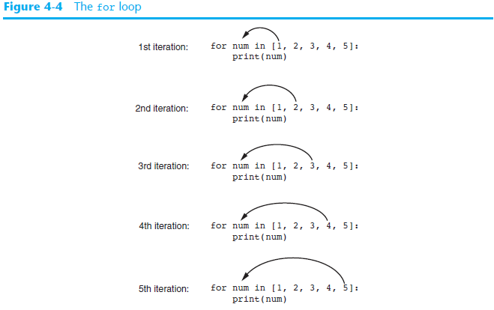

Slide 29
The for Loop: a Count-Controlled Loop
# This program will print the same sentence
# by using each name in the list
for name in ["Ecem", "Sahra", "Can", "Cihan", "Deniz", "Yiğit", "Canan"]:
print("Hi", name, "Please come to my party on Saturday!")

Slide 30
The for Loop: a Count-Controlled Loop
print('I will display the odd numbers 1 through 9.')
for num in [1, 3, 5, 7, 9]:
print(num)
# This program also demonstrates a simple for
# loop that uses a list of strings.
for name in ['Ali', 'Emrah', 'Ebru']:
print(name)

Slide 31
Strings and for Loops
Since a string is a simply sequence of characters, the for loop iterates over each character automatically.
for achar in "Go For Python!":
print(achar)

Slide 32
Example
How many times is the word HELLO printed by the following statements?
s = "Python Rocks"
for ch in s:
print("HELLO")
10
11
12
Error, the for statement needs to use the range function.

Slide 33
Example
How many times is the word HELLO printed by the following statements?
s = "Python Rocks"
for ch in s[3:8]:
print("HELLO")
4
5
6
Error, the for statement cannot use slice.

Slide 34
The for Loop: a Count-Controlled Loop
# This program demonstrates how the range
# function can be used with a for loop.
# Print a message five times.
for x in range(5):
print('Hello world!')

Slide 35
A Simple Definite Loop
Yes
Done?
No
for i in [5, 4, 3, 2, 1]:
print(i)
print('Blastoff!')
5
4
3
2
1
Blastoff!
Move i ahead
print(i)
print('Blast off!')
Definite loops (for loops) have explicit iteration variables that change each time through a loop. These iteration variables move through the sequence or set.

Slide 36
Looking at in...
The iteration variable “iterates” through the sequence (ordered set)
The block (body) of code is executed once for each value in the sequence
The iteration variable moves through all of the values in the sequence
Five-element sequence
Iteration variable
for i in [5, 4, 3, 2, 1]:
print(i)

Slide 37
The iteration variable “iterates” through the sequence (ordered set)
The block (body) of code is executed once for each value in the sequence
The iteration variable moves through all of the values in the sequence
Yes
No
Done?
Move i ahead
print(i)
for i in [5, 4, 3, 2, 1] :
print(i)

Slide 38
i = 5
Yes
No
Done?
print(i)
Move i ahead
i = 4
print(i)
print(i)
i = 3
print(i)
for i in [5, 4, 3, 2, 1] :
print(i)
i = 2
print(i)
i = 1
print(i)

Slide 39
Using the range Function with the for Loop
The range function simplifies the process of writing a for loop
  range returns an iterable object
    Iterable: contains a sequence of values that can be iterated over
range characteristics:
  One argument: used as ending limit
  Two arguments: starting value and ending limit
  Three arguments: third argument is step value

Slide 40
Using the Target Variable Inside the Loop
Purpose of target variable is to reference each item in a sequence as the loop iterates
Target variable can be used in calculations or tasks in the body of the loop
  Example: calculate square root of each number in a range

Slide 41
Using the Target Variable Inside the Loop
# Print the numbers 1 through 10
# and their squares.
for number in range(1, 11):
square = number**2
print(number, '\t', square)
Output:
1 1
2 4
3 9
4 16
5 25
6 36
7 49
8 64
9 81
10 100

Slide 42
Letting the User Control the Loop Iterations
Sometimes the programmer does not know exactly how many times the loop will execute
Can receive range inputs from the user, place them in variables, and call the range function in the for clause using these variables
  Be sure to consider the end cases: range does not include the ending limit

Slide 43
Using the Target Variable Inside the Loop
print('This program displays a list of numbers')
print('and their squares.')
start = int(input('Enter the starting number: '))
end = int(input('How high should I go? '))
print()
print('Number\tSquare')
print('--------------')
for number in range(start, end + 1):
square = number**2
print(number, '\t', square)

Slide 44
Generating an Iterable Sequence that Ranges from Highest to Lowest
The range function can be used to generate a sequence with numbers in descending order
  Make sure starting number is larger than end limit, and step value is negative
  Example: range (10, 0, -1)

Slide 45
Calculating a Running Total
Programs often need to calculate a total of a series of numbers
  Typically include two elements:
    A loop that reads each number in series
    An accumulator variable
  Known as program that keeps a running total: accumulates total and reads in series
  At end of loop, accumulator will reference the total

Slide 46
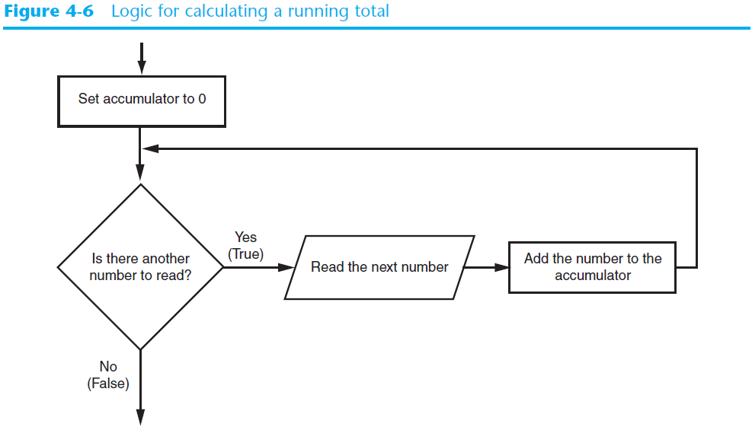
Calculating a Running Total (cont’d.)

Slide 47
Calculating a Running Total (cont’d.)
max = int(input('Maximum value:')) # The maximum number
# Initialize an accumulator variable.
total = 0.0
s = ', '
list_1 = []
# Explain what we are doing.
print('This program calculates the sum of')
print(max, 'numbers you will enter.')
# Get the numbers and accumulate them.
for counter in range(max):
number = int(input('Enter a number: '))
list_1.append(str(number))
print(s.join(list_1))
print(' - '.join(list_1))
total = total + number
# Display the total of the numbers.
print('The total is', total)

Slide 48
The Augmented Assignment Operators
In many assignment statements, the variable on the left side of the = operator also appears on the right side of the = operator
Augmented assignment operators: special set of operators designed for this type of job
  Shorthand operators

Slide 49
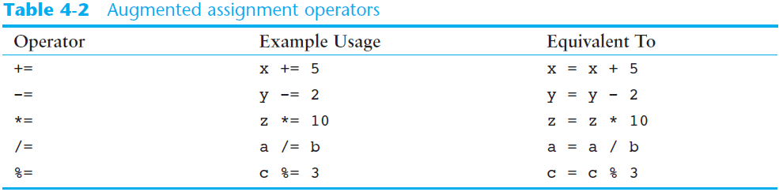
The Augmented Assignment Operators (cont’d.)
for counter in range(max):
number = int(input('Enter a number: '))
total += number

Slide 50
Example
nums = [1, 2, 3, 4, 5, 6, 7, 8, 9, 10]
for w in nums:
accum = 0
accum = accum + w
print(accum)
What happens if you put the initialization of accum inside the for loop as the first instruction in the loop?
A. It will print out 10 instead of 55
B. It will cause a run-time error
C. It will print out 0 instead of 55

Slide 51
Example
Write code to create a list of integers from 0 through 52 and assign that list to the variable numbers. You should use a special Python function – do not type out the whole list yourself.
Notes:
numbers=[]
for i in range(52):
numbers.append(i+1)
print(numbers)

Slide 52
Example
Count the number of characters in string str1. Do not use len(). Save the number in variable numbs.
str1 = "I like nonsense, it wakes up the brain cells. Fantasy is a necessary ingredient in living."
Notes:
str1 = "I like nonsense, it wakes up the brain cells. Fantasy is a necessary ingredient in living."
numbs=0
for i in str1:
numbs+=1
print(numbs)

Slide 53
Example
Create a list of numbers 0 through 40 and assign this list to the variable numbers. Then, accumulate the total of the list’s values and assign that sum to the variable sum1.
Notes:
numbers=[]
sum1=0
for i in range (41):
numbers.append(i)
sum1+=numbers[i]
print(numbers)
print(sum1)

Slide 54
Example
How many times is the letter P printed by the following statements?
s = "Python"
for idx in range(len(s)):
print(s[idx % 2])
0
1
2
3
6

Slide 55
Sentinels
Sentinel: special value that marks the end of a sequence of items
  When program reaches a sentinel, it knows that the end of the sequence of items was reached, and the loop terminates
  Must be distinctive enough so as not to be mistaken for a regular value in the sequence
  Example: when reading an input file, empty line can be used as a sentinel

Slide 56
Sentinels
TAX_FACTOR = 0.0065 # Represents the tax factor.
print('Enter the property lot number')
print('or enter 0 to end.')
lot = int(input('Lot number: '))
while lot != 0:
value = float(input('Enter the property value: '))
tax = value * TAX_FACTOR
print('Property tax: $', format(tax, ',.3f'), sep='')
print('Enter the next lot number or')
print('enter 0 to end.')
lot = int(input('Lot number: '))

Slide 57
Sentinels
Enter the property lot number
or enter 0 to end.
Lot number: 5
Enter the property value: 56
Property tax: $0.36
Enter the next lot number or
enter 0 to end.
Lot number: 87
Enter the property value: 3
Property tax: $0.02
Enter the next lot number or
enter 0 to end.
Lot number: 0
>>>

Slide 58
Input Validation Loops
Computer cannot tell the difference between good data and bad data
  If user provides bad input, program will produce bad output
  GIGO: garbage in, garbage out
  It is important to design program such that bad input is never accepted

Slide 59
Input Validation Loops
mark_up = 2.5 # The markup percentage
another = 'y' # Variable to control the loop.
while another == 'y' or another == 'Y':
wholesale = float(input("Enter the item's " + \
"wholesale cost: "))
retail = wholesale * mark_up
print('Retail price: $', format(retail, ',.2f'), sep='')
another = input('Do you have another item? ' + \
'(Enter y for yes): ')

Slide 60
Input Validation Loops
Enter the item's wholesale cost: 25
Retail price: $62.50
Do you have another item? (Enter y for yes): Y
Enter the item's wholesale cost: 50
Retail price: $125.00
Do you have another item? (Enter y for yes): y
Enter the item's wholesale cost: 100
Retail price: $250.00
Do you have another item? (Enter y for yes): q
>>>

Slide 61
Input Validation Loops (cont’d.)
Input validation: inspecting input before it is processed by the program
  If input is invalid, prompt user to enter correct data
  Commonly accomplished using a while loop which repeats as long as the input is bad
    If input is bad, display error message and receive another set of data
    If input is good, continue to process the input

Slide 62
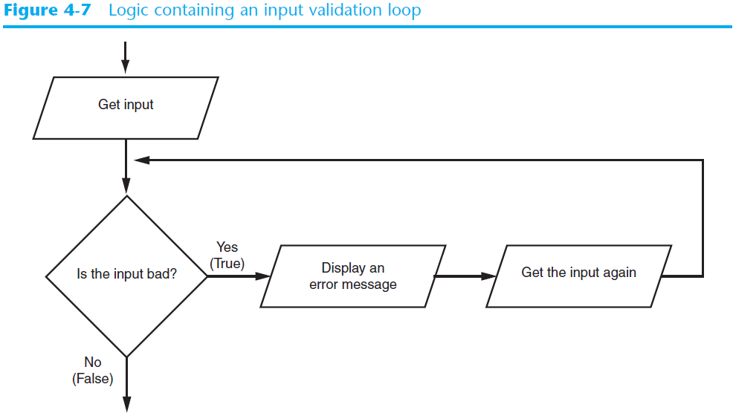
Input Validation Loops (cont’d.)

Slide 63
Input Validation Loops
mark_up = 2.5 # The markup percentage
another = 'y' # Variable to control the loop.
while another == 'y' or another == 'Y':
wholesale = float(input("Enter the item's " + \
"wholesale cost: "))
while wholesale < 0:
print('ERROR: the cost cannot be negative.')
wholesale = float(input('Enter the correct ' + \
'wholesale cost:'))
retail = wholesale * mark_up
print('Retail price: $', format(retail, ',.2f'), sep='')
another = input('Do you have another item? ' + \
'(Enter y for yes): ')

Slide 64
Input Validation Loops
Enter the item's wholesale cost: 50
Retail price: $125.00
Do you have another item? (Enter y for yes): y
Enter the item's wholesale cost: 100
Retail price: $250.00
Do you have another item? (Enter y for yes): Y
Enter the item's wholesale cost: -50
ERROR: the cost cannot be negative.
Enter the correct wholesale cost:25
Retail price: $62.50
Do you have another item? (Enter y for yes): q
>>>

Slide 65
Nested Loops
Nested loop: loop that is contained inside another loop
  Example: analog clock works like a nested loop
    Hours hand moves once for every twelve movements of the minutes hand: for each iteration of the “hours,” do twelve iterations of “minutes”
    Seconds hand moves 60 times for each movement of the minutes hand: for each iteration of “minutes,” do 60 iterations of “seconds”

Slide 66
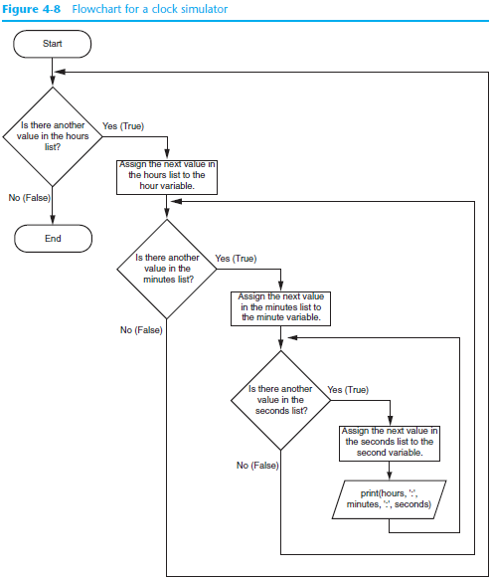

Slide 67
Nested Loops
num_students = int(input('How many students do you have? '))
num_test_scores = int(input('How many test scores per student? '))
for student in range(num_students):
total = 0.0
print('Student number', student + 1)
print('-----------------')
for test_num in range(num_test_scores):
print('Test number', test_num + 1, end='')
score = float(input(': '))
# Add the score to the accumulator.
total += score
average = total / num_test_scores
print('The average for student number', student + 1, \
'is:', format(average, '.1f'))
print()

Slide 68
Nested Loops
How many students do you have? 3
How many test scores per student? 2
Student number 1
-----------------
Test number 1: 34
Test number 2: 89
The average for student number 1 is: 61.5
Student number 2
-----------------
Test number 1: 12
Test number 2: 78
The average for student number 2 is: 45.0
Student number 3
-----------------
Test number 1: 78
Test number 2: 45
The average for student number 3 is: 61.5

Slide 69
Nested Loops (cont’d.)
Key points about nested loops:
  Inner loop goes through all of its iterations for each iteration of outer loop
  Inner loops complete their iterations faster than outer loops
  Total number of iterations in nested loop: number_iterations_inner x
  number_iterations_outer

Slide 70
Finding the Largest Value
$ python largest.py
Before -1
9 9
41 41
41 12
41 3
74 74
74 15
After 74
largest_so_far = -1
print('Before', largest_so_far)
for the_num in [9, 41, 12, 3, 74, 15] :
if the_num > largest_so_far :
largest_so_far = the_num
print(largest_so_far, the_num)
print('After', largest_so_far)
We make a variable that contains the largest value we have seen so far. If the current number we are looking at is larger, it is the new largest value we have seen so far.

Slide 71
More Loop Patterns…

Slide 72
Counting in a Loop
count = 0
print('Before', count)
for thing in [9, 41, 12, 3, 74, 15] :
count = count + 1
print(count, thing)
print('After', count)
$ python countloop.py
Before 0
1 9
2 41
3 12
4 3
5 74
6 15
After 6
To count how many times we execute a loop, we introduce a counter variable that starts at 0 and we add one to it each time through the loop.

Slide 73
Summing in a Loop
sum = 0
print('Before', sum)
for thing in [9, 41, 12, 3, 74, 15] :
sum = sum + thing
print(sum, thing)
print('After', sum)
$ python countloop.py
Before 0
9 9
50 41
62 12
65 3
139 74
154 15
After 154
To add up a value we encounter in a loop, we introduce a sum variable that starts at 0 and we add the value to the sum each time through the loop.

Slide 74
Finding the Average in a Loop
count = 0
sum = 0
print('Before', count, sum)
for value in [9, 41, 12, 3, 74, 15] :
count = count + 1
sum = sum + value
print(count, sum, value)
print('After', count, sum, sum / count)
$ python averageloop.py
Before 0 0
1 9 9
2 50 41
3 62 12
4 65 3
5 139 74
6 154 15
After 6 154 25.666
An average just combines the counting and sum patterns and divides when the loop is done.

Slide 75
Filtering in a Loop
print('Before')
for value in [9, 41, 12, 3, 74, 15] :
if value > 20:
print('Large number',value)
print('After')
$ python search1.py
Before
Large number 41
Large number 74
After
We use an if statement in the loop to catch / filter the values we are looking for.

Slide 76
Search Using a Boolean Variable
found = False
print('Before', found)
for value in [9, 41, 12, 3, 74, 15] :
if value == 3 :
found = True
print(found, value)
print('After', found)
$ python search1.py
Before False
False 9
False 41
False 12
True 3
True 74
True 15
After True
If we just want to search and know if a value was found, we use a variable that starts at False and is set to True as soon as we find what we are looking for.

Slide 77
How to Find the Largest Value
largest_so_far = -1
print('Before', largest_so_far)
for the_num in [9, 41, 12, 3, 74, 15] :
if the_num > largest_so_far :
largest_so_far = the_num
print(largest_so_far, the_num)
print('After', largest_so_far)
$ python largest.py
Before -1
9 9
41 41
41 12
41 3
74 74
74 15
After 74
How would we change this to make it find the smallest value in the list?

Slide 78
Finding the Smallest Value
smallest_so_far = -1
print('Before', smallest_so_far)
for the_num in [9, 41, 12, 3, 74, 15] :
if the_num < smallest_so_far :
smallest_so_far = the_num
print(smallest_so_far, the_num)
print('After', smallest_so_far)
$ python smallest.py
Before -1
-1 9
-1 41
-1 12
-1 3
-1 74
-1 15
After -1
We switched the variable name to smallest_so_far and switched the > to <

Slide 79
Finding the Smallest Value
smallest = None
print('Before')
for value in [9, 41, 12, 3, 74, 15] :
if smallest is None :
smallest = value
elif value < smallest :
smallest = value
print(smallest, value)
print('After', smallest)
$ python smallest.py
Before
9 9
9 41
9 12
3 3
3 74
3 15
After 3
We still have a variable that is the smallest so far. The first time through the loop smallest is None, so we take the first value to be the smallest.

Slide 80
The is and is not Operators
smallest = None
print('Before')
for value in [3, 41, 12, 9, 74, 15] :
if smallest is None :
smallest = value
elif value < smallest :
smallest = value
print(smallest, value)
print('After', smallest)
Python has an is operator that can be used in logical expressions
Implies “is the same as”
Similar to, but stronger than ==
is not also is a logical operator

Slide 81
Turtle Graphics: Using Loops to Draw Designs
You can use loops with the turtle to draw both simple shapes and elaborate designs. For example, the following for loop iterates four times to draw a square that is 100 pixels wide:
for x in range(4):
turtle.forward(100)
turtle.right(90)

Slide 82
Turtle Graphics: Using Loops to Draw Designs
This for loop iterates eight times to draw the octagon:
for x in range(8):
turtle.forward(100)
turtle.right(45)

Slide 83
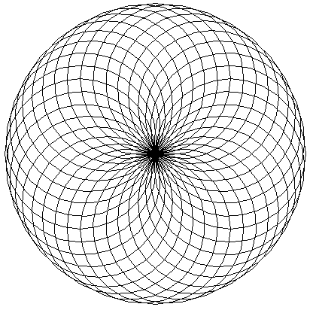
Turtle Graphics: Using Loops to Draw Designs
You can create interesting designs by repeatedly drawing a simple shape, with the turtle tilted at a slightly different angle each time it draws the shape.
NUM_CIRCLES = 36 # Number of circles to draw
RADIUS = 100 # Radius of each circle
ANGLE = 10 # Angle to turn
for x in range(NUM_CIRCLES):
turtle.circle(RADIUS)
turtle.left(ANGLE)

Slide 84
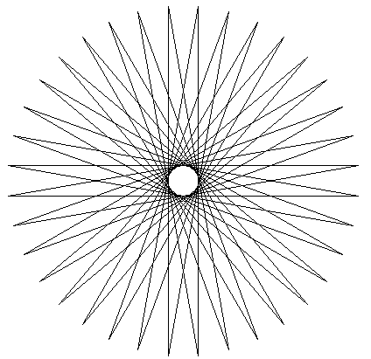
Turtle Graphics: Using Loops to Draw Designs
This code draws a sequence of 36 straight lines to make a "starburst" design.
START_X = -200 # Starting X coordinate
START_Y = 0 # Starting Y coordinate
NUM_LINES = 36 # Number of lines to draw
LINE_LENGTH = 400 # Length of each line
ANGLE = 170 # Angle to turn
turtle.hideturtle()
turtle.penup()
turtle.goto(START_X, START_Y)
turtle.pendown()
for x in range(NUM_LINES):
turtle.forward(LINE_LENGTH)
turtle.left(ANGLE)

Slide 85
Summary
This chapter covered:
  Repetition structures, including:
    Condition-controlled loops
    Count-controlled loops
    Nested loops
  Infinite loops and how they can be avoided
  range function as used in for loops
  Calculating a running total and augmented assignment operators
  Use of sentinels to terminate loops
  Using loops to draw turtle graphic designs

Slide 86


Acknowledgements / Contributions
These slides are Copyright 2010- Charles R. Severance (www.dr-chuck.com) of the University of Michigan School of Information and open.umich.edu and made available under a Creative Commons Attribution 4.0 License. Please maintain this last slide in all copies of the document to comply with the attribution requirements of the license. If you make a change, feel free to add your name and organization to the list of contributors on this page as you republish the materials.
Initial Development: Charles Severance, University of Michigan School of Information
… Insert new Contributors and Translators here
...

